Slide 1


FINAL YEAR
PROJECT
Adam O’Mahony T00227115

Slide 2



Why is there a divide between the Theoretical definition of Microservice Architecture when it comes to Databases and their Implementation?

Slide 3






MAIN RESEARCH AREAS
Distributed Databases
Database Replication | Database Architecture | Database Models | Sharding
Microservices
Microservices Overview | Consistency Challenges | Saga Patterns | Event Driven
Database Technologies
Database Middleware | Edge Databases | Immutable Databases | Change Data Capture

Slide 4


KEY FINDINGS
01
Database Management - Key pain point for microservices database per service.
02
Database Replication - Applied only to larger
databases. not edge databases.
03
Data Consistency - A requirement for many
systems across replicas.
04
Always a Trade-off - Every replication or consistency solution has inherent pros and cons.

Slide 5





Project Design - Database Management System Middleware
01
Database Management - add databases and provide a central hub for database admin.
02
Database Replication - Provide Replication for small databases attached to Microservices.
03
Data Consistency Strategies - Ability to apply consistency strategy to a database.
04
Replication Sync Checker - Checking of data consistency between replications.

Slide 6

Prototype
The Prototype allowed databases to be added to the system, and then revealed an issue with the connectivity of external middleware to Edge Databases.
A work around was found for H2 databases, however, this brought up a fundamental issue with the plan of creating a generic “Silver Bullet Solution”.
Therefore a pivot towards creation of a database system that satisfys the requirements of data consistency and connectivity that a microservice management system requires.

Slide 7




Revised Project Pivot
New Project Proposal to create an immutable database or database wrapper that has in built logging and replication.
Middleware management system still under consideration to takle the issue of database administration.
Strong Data Consistency
Asynchronous Master - Master Replication
Immutable Data

Slide 8


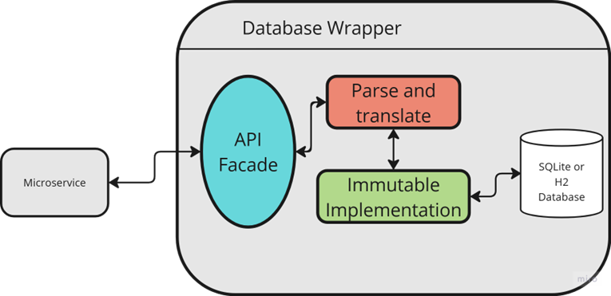
Thank you for listening

